Slide 1
Do you know what you own?
Notes:
-Intro -

Slide 2
Register your
property online
Benefits:
It’s secure.
You can access the information from anywhere.
If there’s a theft or natural disaster, it will be invaluable to you, your insurance company and the detective working your case.
It’s FREE!

Slide 3
Go to
reportit.leadsonline.com

Slide 4
Create your free ReportIt account

Slide 5
Login to your new
ReportIt account

Slide 6
Start cataloguing
your property

Slide 7
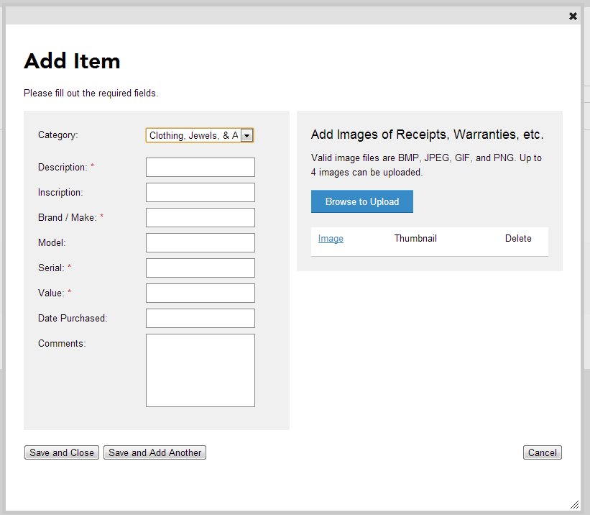
What makes your property unique?
Helpful hints:
Be specific.
Fill in as much information as possible.
Upload photos and scans of receipts. It’s especially important for jewelry and property that does not have a serial number.

Slide 8
Print a report of
your property

Slide 9
Print a report of
your property

Slide 10
FAQs Answered
How secure is the information I enter?
Are police able to search through the property I enter?
What type of property can I enter?
What does it cost to store my information?
Any other questions?

Slide 11
Get started today!
Go to reportit.leadsonline.com

